Slide 1
Twitter Disaster Analysis
Maria Mahbub, Linsey S. Passarella, Emily Joyce Herron and Gerald Leon Jones

Slide 2
Introduction

Slide 3
Main questions and Goals
studies show rural low income areas more adversely affected during disasters
Can this affect be observed by analyzing Twitter
Compare/Contrast analysis techniques for reproducibility
Are some techniques better for this type of analysis

Slide 4
Main tasks:
Collect clean and parse data
Decide on classification methods
Decide on analysis methods
Analyze compare and contrast results

Slide 5
Data Collection and Cleaning

Slide 6
Data Collection
Tweets containing '\#hurricaneflorence' obtained from twitter
Three ways were available
AIDR (Artificial Intelligence for Digital Response)
can collect data with just one click
time consuming
have limitations in identifying keywords & download limitations
Python codes to get tweets directly using the Twitter API’s
restrictions because of the API's rate limits
can collect very few tweets (around 7000)
Python codes* built on Scrapy
can get tweets from Twitter Search without using Twitter API's.
can collect fairly large amount of tweets (around 200,000)
used these codes to get tweets for our project
*codes source: github repository (https://github.com/DisasterMasters).

Slide 7
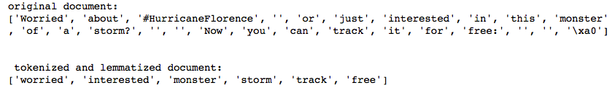
Data Cleaning - Python
The gensim library's utils.simple_preprocess function and parsing.preprocessing.STOPWORDS list used to lowercase words and remove all links, hashtags, punctuation, stopwords. Words of length less than 3 also removed. The result was a cleaned and tokenized version of each tweet.

Slide 8
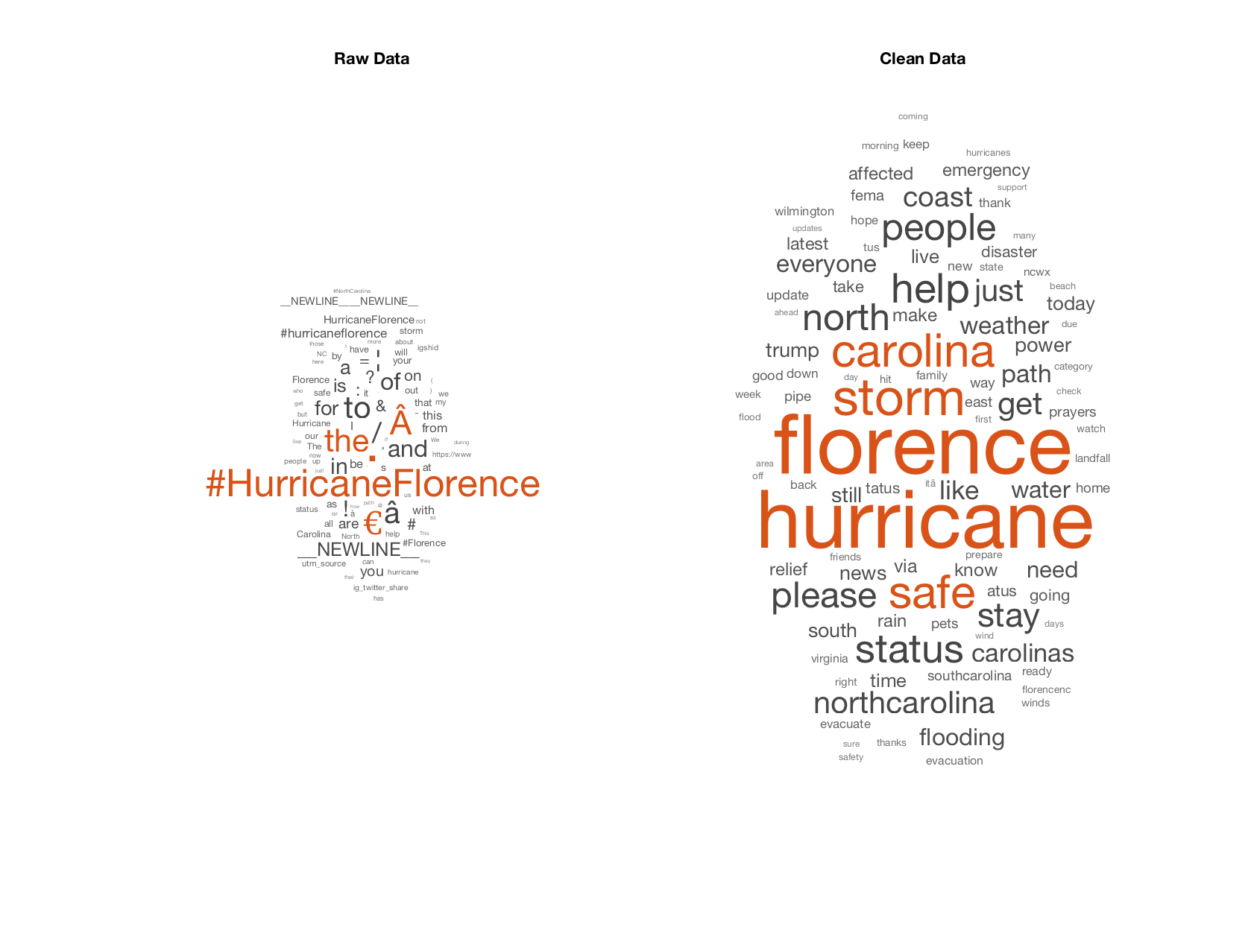
Data Cleaning - MATLAB
All hash tags '\#', stopwords, punctuation marks, usermentions, and embedded URLs not part of the main text of the tweet were removed. After cleaning, the tweets were tokenized.
Notes:
To prepare for analyzing the tweets, hash tags '\#', stopwords, punctuation marks and usermentions were removed along with embedded URLs which were not part of the main text of the tweet. After cleaning, the tweets were tokenized.

Slide 9
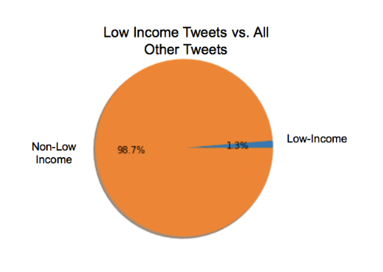
Low-income related tweets
"In Poor, Rural Communities, Fleeing Hurricane Florence Was Tough".
If the tweet contained one of the following words, it would be separated into the low-income list: rural, poor, community, communities, country, countryside, neighborhood, impoverished, poverty, broke, underprivileged, low, income, low-income.
Notes:
A list of words pertaining to low-income or rural areas was created to partition the tweets for analysis. If the tweet contained one of the following words, it would be separated into the low-income list

Slide 10
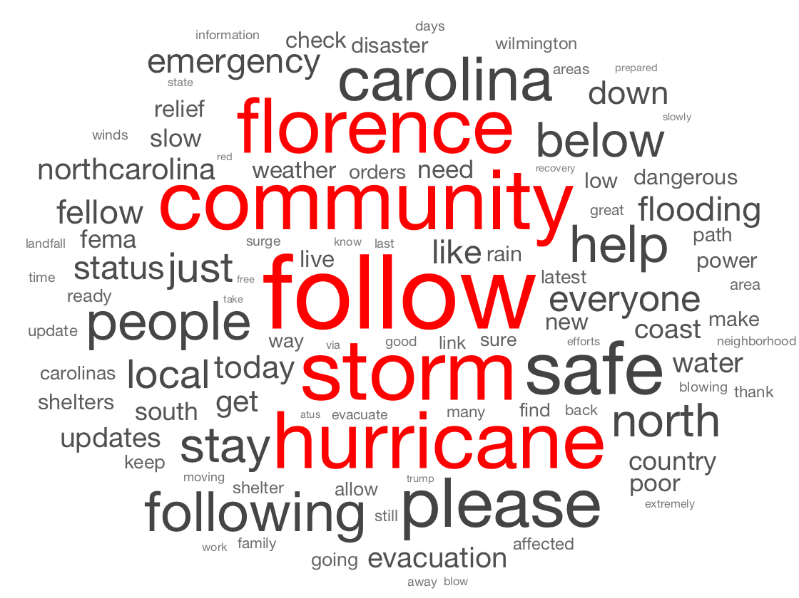
Low-income related tweets

Slide 11
Clustering
LDA Topic Modelling & K-means

Slide 12
Latent Dirichlet Allocation (LDA)

Slide 13
Working Procedure:
Used tools: core package: scikit-learn (sklearn)
pyLDAvis and matplotlib for visualization
numpy and pandas for manipulating and viewing data in tabular format.
Main Input of LDA:
Convert a collection of text documents to a matrix of token counts.
Word properties:
Frequency at least 10.
has to contain numbers and alphabets of at least length 3.
Working Procedure:
Convert words to lowercase.
Use CountVectorizer class to perform tokenization
Apply fit_transform create the matrix
Fix Number of Topics and Learning Decay:
Run multiple LDA models on a range of number of topics and learning decays to achieve the best parameters

Slide 14
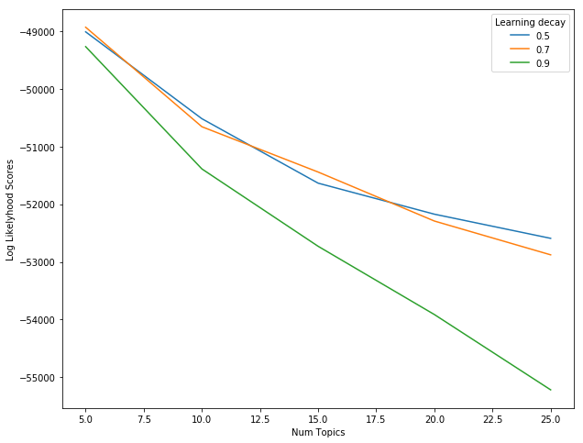
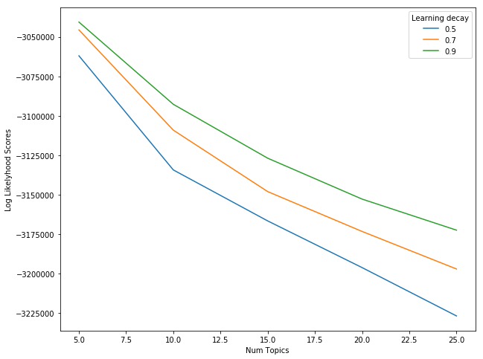
Number of Topics and Learning Dacay
Perplexity ~ 360
Perplexity ~ 1496
Fig. : Choosing optimal LDA model for rural tweets
Fig. : Choosing optimal LDA model for nonrural tweets
A model with higher log-likelihood & lower perplexity indicates well performing models
Notes:
49000
3M

Slide 15
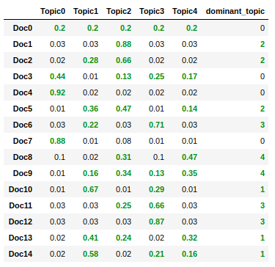
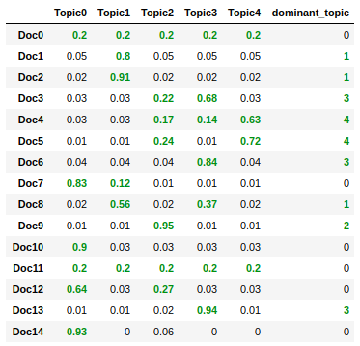
Classify Tweets
LDA assigned each document to a mixture of topics.
Hence, each topic is characterized by one or more topics.
Fig. : Dominant topics for top 15 tweets
Fig. : Dominant topics for top 15 tweets
Approach:
Consider each tweet as a separate document
See which topic has the highest contribution
Assign it to the document

Slide 16
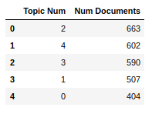
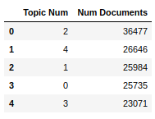
Classify Tweets
Fig. : Number of Rural Tweets based on Topics
Fig. : Number of Non-Rural Tweets based on Topics

Slide 17
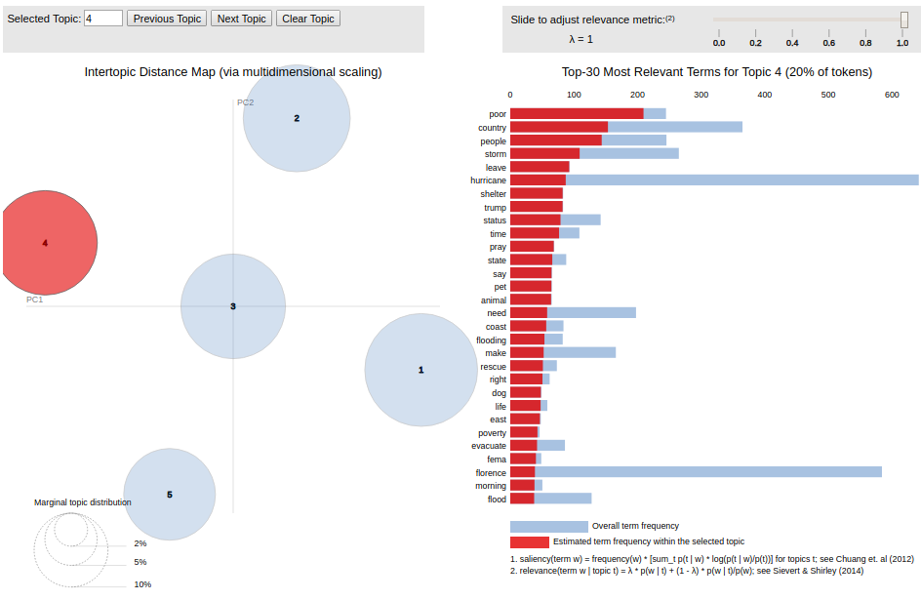
Visualization of LDA models
Fig. : LDA Topic Model for Rural Tweets
Notes:
the blue bars represent overall term frequency whereas the red bars represent the term frequency within the selected topic.

Slide 18
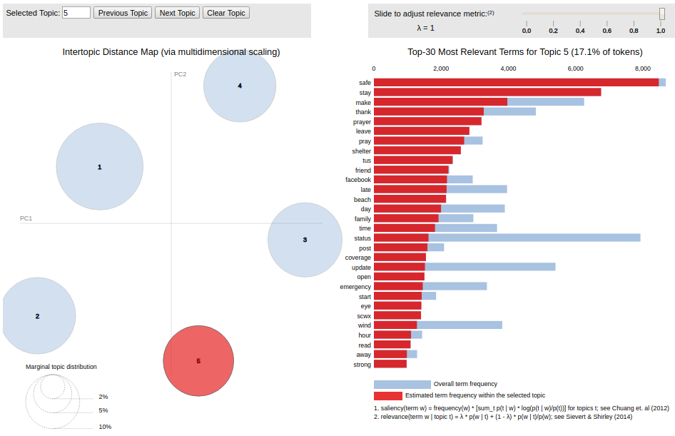
Visualization of LDA models
Fig. : LDA Topic Model for Non-Rural Tweets

Slide 19
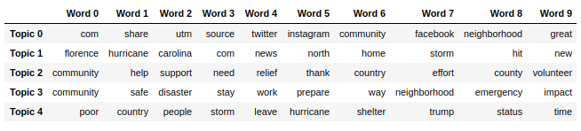
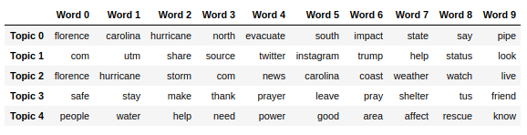
Topic Distribution of the Tweets
Social media (15.4%)
Hurricane & Media (20.1%)
Help & Relief (23.4%)
Safety Measure & Concern (21%)
Poverty (20%)
Fig. Top ten keywords present in each topic in the rural tweets
Disaster & Impact (18%)
Social media (19%)
Hurricane & Media (25.9%)
Safety Measure & Concern (17.1%)
Help & Relief (20.1%)
Fig. Top ten keywords present in each topic in the nonrural tweets

Slide 20
K-Means Clustering

Slide 21
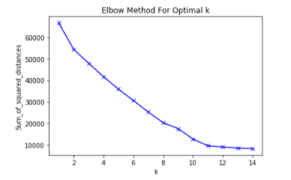
K-Means Clustering Procedure
K-Means clustering was used to cluster similar tweets.
The text of each tweet was vectorized using Scikit-Learn's TfidfVectorizer function and the corpus was stored in a matrix of TF-IDF values.
Vectorized tweets were clustered using different values for k. An optimal k-value of 11 was chosen by calculating the sum of squared distances for each clustering, graphing these values and applying the elbow method.
An optimal k of 11 was chosen using the elbow method.

Slide 22
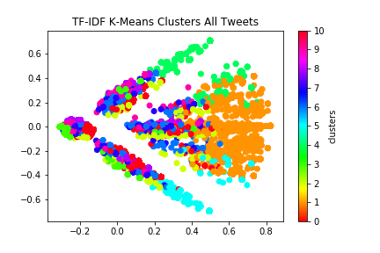
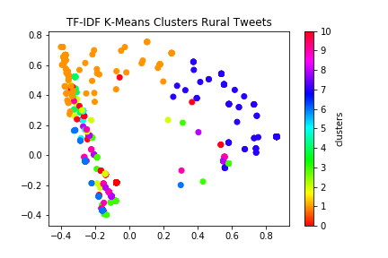
K-Means Scatterplots

Slide 23
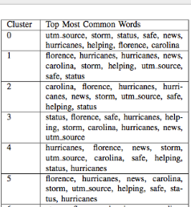
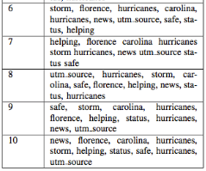
Top 10 Words in Each Cluster

Slide 24
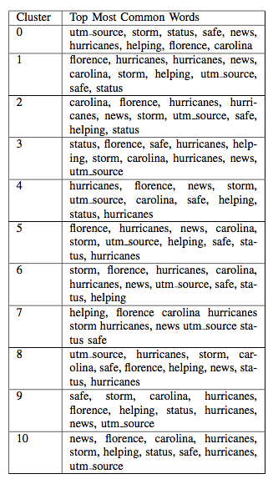
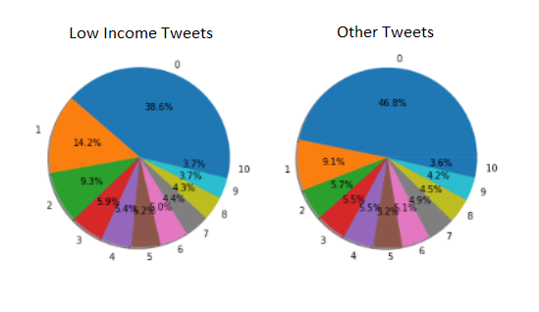
Comparing K-Means Terms by Socioeconomic Status

Slide 25
K-Means Clustering: Key Findings
Each cluster seemed to have relatively similar values for its most common words.
The key difference between the clusters is each words rank in popularity
The rural/low-income subset of tweets had a smaller proportion of tweets falling into cluster 0 and a larger proportion of tweets representing clusters 1 and 2.

Slide 26
What are the differences between these two?
Both K-means and Latent Dirichlet Allocation (LDA) are unsupervised learning algorithms
Needs to decide a priori the parameter K (K-Means: number of clusters, LDA: number of topics)
Applied both to assign K topics to a set of tweets (N documents)
Noticed: optimum number of topic distribution
LDA: 5
K-Means: 11
Probable Reason:
K-means partitioned the documents set in K disjoint topics
LDA assigned each document to a mixture of topics. Hence, each topic is characterized by one or more topics.

Slide 27
Benefits and Drawbacks of LDA and K-Means
LDA:
Pros: Produces list of topics in corpus alongside list of specific keywords representing each topic.
Cons: Method not designed to assign topics to individual tweets, takes hours to Grid Search
K-Means:
Pros: Assigns each tweet to a specific cluster based on similarity.
Cons: Does not directly yield list of topics defining each cluster.

Slide 28
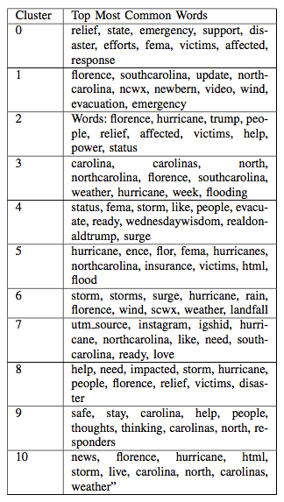
Applying LDA to K-Means Clusters
LDA applied to K-Means Clusters to obtain a list of key topics for each.

Slide 29
Sentiment Analysis
Support Vector Machine and Python TextBlob

Slide 30
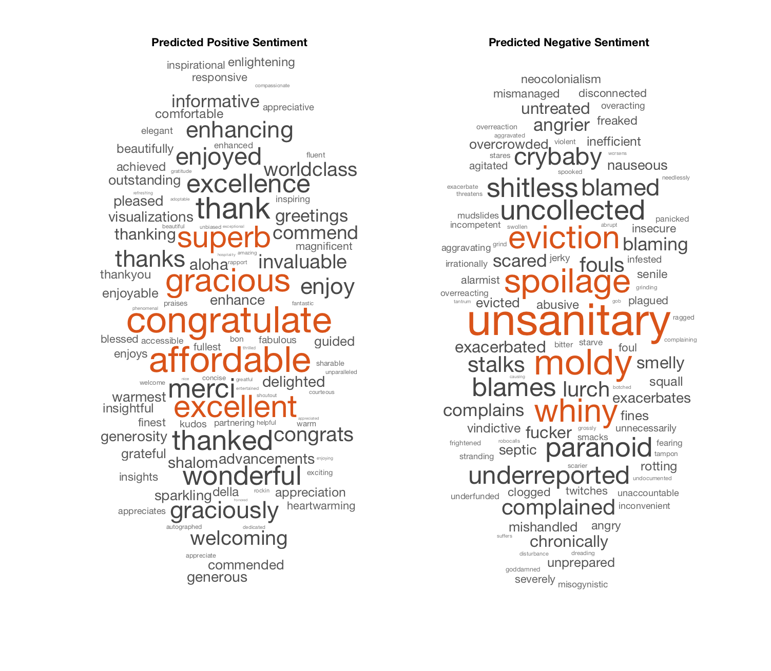
Support Vector Machine (SVM) in MATLAB
A sentiment word list compiled by the University of Illinois Chicago was used to train the SVM to predict the sentiments of tweets used in this study (6,790 words that were categorically labeled either "positive" or "negative")
SVM ran on the Florence twitter dataset and output a sentiment score for the individual words in the tweet >0 being positive and <0 being negative
Notes:
A support vector machine (SVM) was used as one method of conducting a sentiment analysis on the datasets. The words in both the sentiment list and the tweet datasets were converted to word vectors using MATLAB's built-in word embedding. After the SVM was trained, it ran on the Florence twitter dataset and output a sentiment score for the individual words in the tweet.

Slide 31
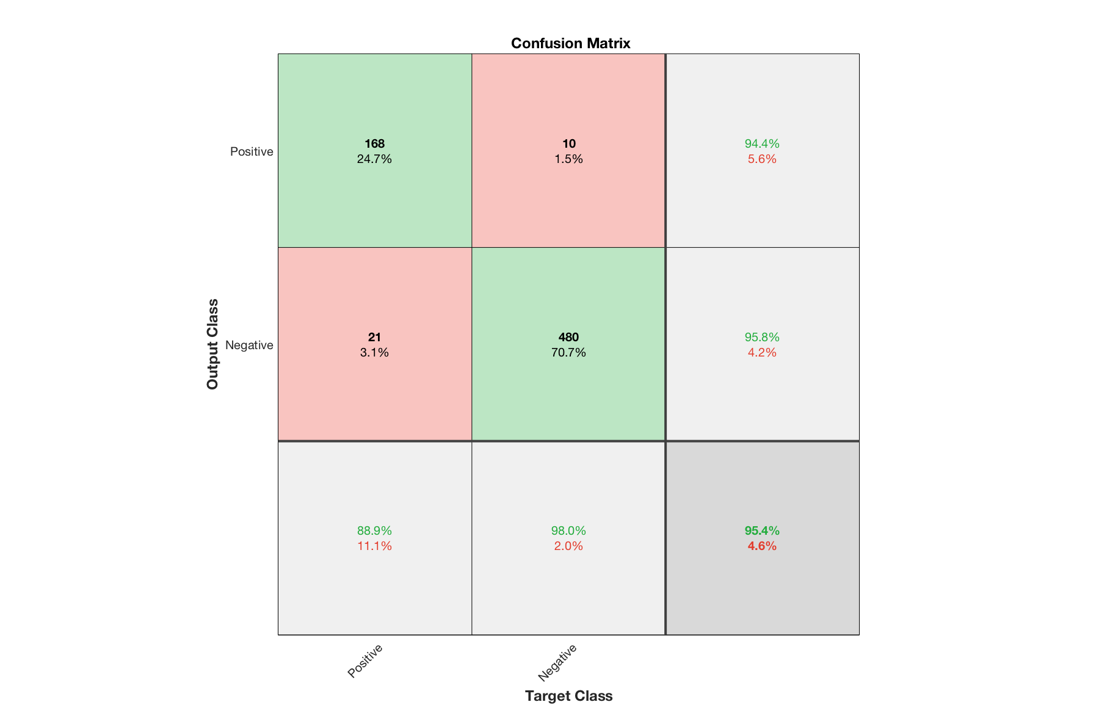
SVM in MATLAB

Slide 32
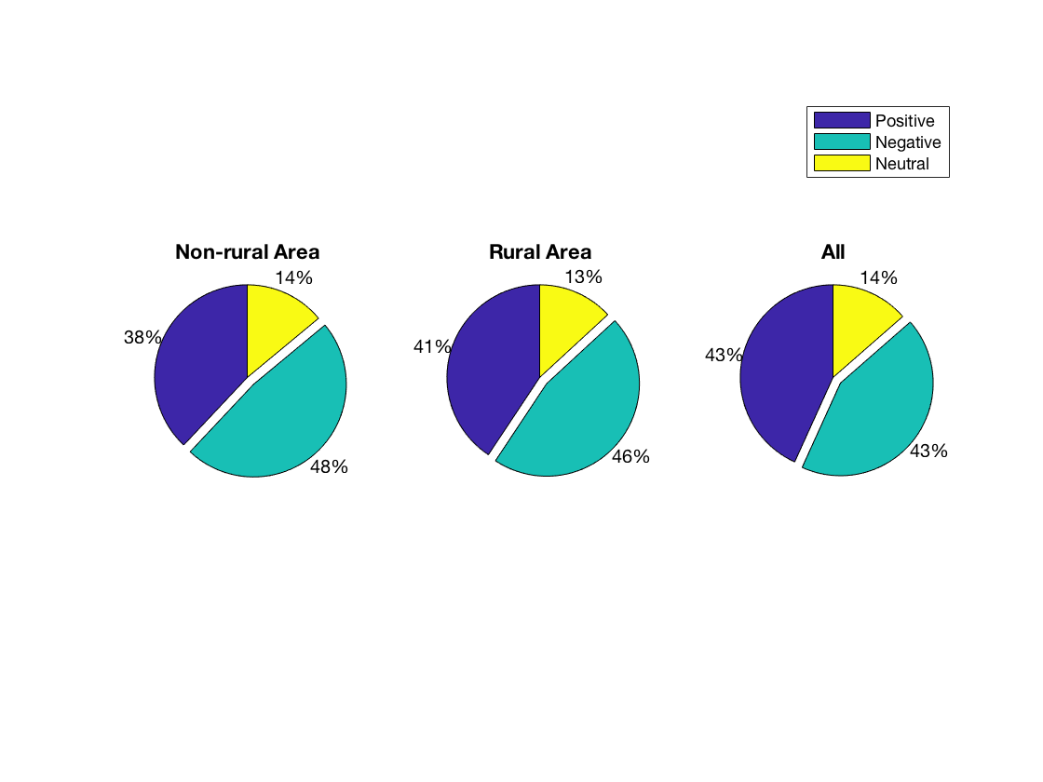
SVM in MATLAB
There were several instances of words that were not recognized by the built-in word embedding, these words were removed
Tweets given a score between -0.3 and 0.3 were counted as neutral
Overall, the non-rural area related tweets had the highest percent of negative tweets, but not by a significant amount.

Slide 33
Issues with SVM
No categorically labeled “neutral” sentiments
Average sentiment of all words in a tweet was used for the sentiment of the whole tweet
Many words in the tweets were not recognized by the built-in word embeddings, so they were not given a sentiment score

Slide 34
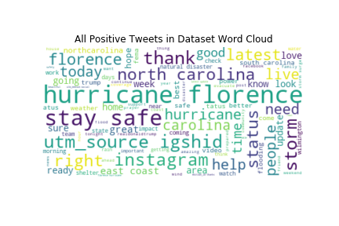
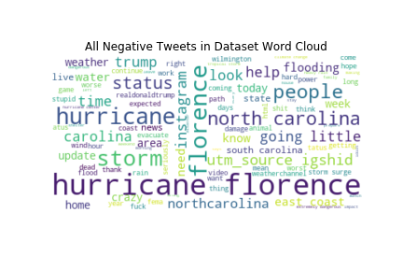
TextBlob in Python
Sentiment analysis was performed on text of each tweet using Python's TextBlob library for NLP.
All tweets passed to the TextBlob class's sentiment function, which yielded a polarity value between -1.0 and 1.0, denoting a sentiment classification of either negative (sentiment < 0), positive (sentiment > 0), or neutral (sentiment = 0).
Word clouds were constructed from the words of tweets identified as either positive, negative or neutral.

Slide 35
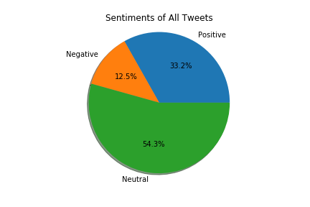
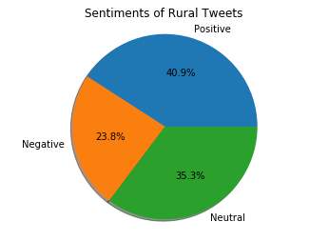
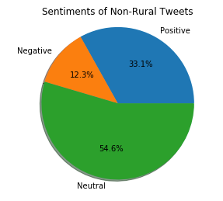
Comparing Sentiments by Socioeconomic Status
46,225 tweets classified as positive, 17,357 as negative, and 75,625 as neutral.
The sentiment percentage breakdowns of tweets in the entire dataset, the subset of tweets containing rural/low-income related terms are shown below.
The percentage of neutral tweets lower in the rural/low-income subset than in the set of all other tweets.
The proportions of tweets classified as negative and positive were higher in this subset in comparison to that of all other tweets. The largest percentage of tweets in this subset had a classification of positive.

Slide 36
Conclusions

Slide 37
Pros and Cons: LDA vs. K Means
LDA K-Means
Pros :
Concise model
Easily understandable
Cons:
Time consuming
Pros:
Better at mass clustering
Cons:
Harder to interpret

Slide 38
Comparison of SVM and TextBlob

Slide 39
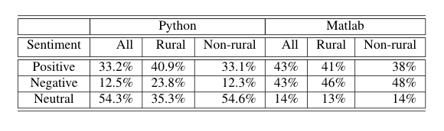
Comparison of SVM and TextBlob
Rural tweets more positive sentiment than non rural
Differences in Python TextBlob vs. Matlab SVM

Slide 40
Future Work
Way of scraping tweets with geographic data
Using geographic data to improve parsing of data
Further analysis of which methods work best for this type of project

Slide 41
Team Member Roles
Maria Mahbub: Data collection, LDA
Linsey S. Passarella: Low-income tweet database, MATLAB Sentiment Analysis/SVM
Emily J. Herron: K-Means, Python Sentiment Analysis
Gerald L. Jones: Research, Comparison analysis, Goal Manager

Slide 42
Questions?

